Slide 1

Customer Segmentation Using RFM and K-Means Clustering
Summary of Methodology, Insights,
and Recommendations
Prepared by Bandi Ramya

Slide 2
Business Problem
Objective:
To segment customers based on purchasing behavior for better-targeted marketing strategies.
Dataset:
Online retail data with customer transactions including purchase history, quantity, and total spend.

Slide 3
Methodology Overview
Step 1: Data Cleaning:
Remove missing and duplicate values.
Convert date fields and filter non-negative values for critical columns like Quantity and Unit price.
Create a Total Price column.
Step 2: Exploratory Data Analysis (EDA):
Visualized customer purchase patterns, sales by country, and average basket size.
Step 3: Feature Engineering:
Created Recency, Frequency, and Monetary (RFM) metrics.
Step 4: Customer Segmentation:
Applied K-Means clustering to group customers based on RFM scores.

Slide 4
Insights from Data Cleaning
Removed 10% of rows with missing Customer IDs to ensure segmentation quality.
Duplicate entries cleaned, ensuring no skew in frequency metrics.
Final cleaned dataset: 35,000+ transactions with 4 critical features for analysis
(Invoice Date, Quantity, Unit Price, and Customer ID).

Slide 5
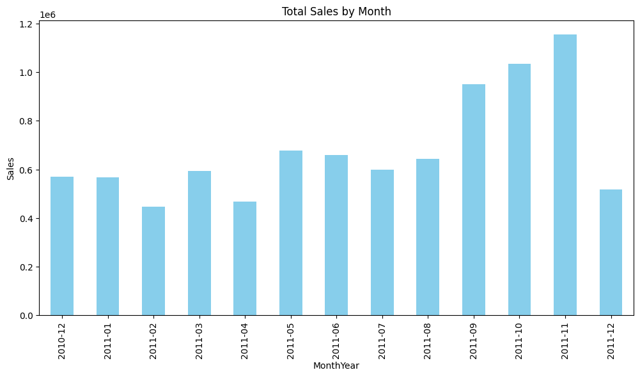
Key EDA Findings
Customer Purchase Patterns:
Peak sales in November and December, showing strong seasonality.
Consistent dip in sales during summer months.

Slide 6
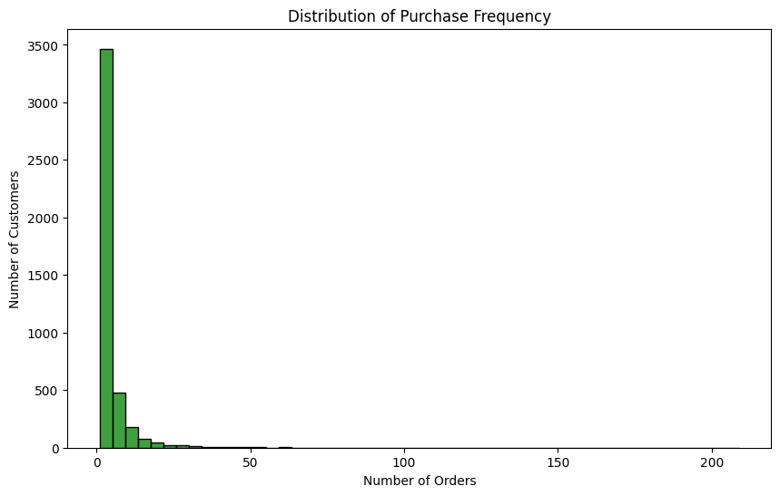
Customer Purchase Frequency:
75% of customers made fewer than 5 purchases, indicating infrequent buyers.

Slide 7
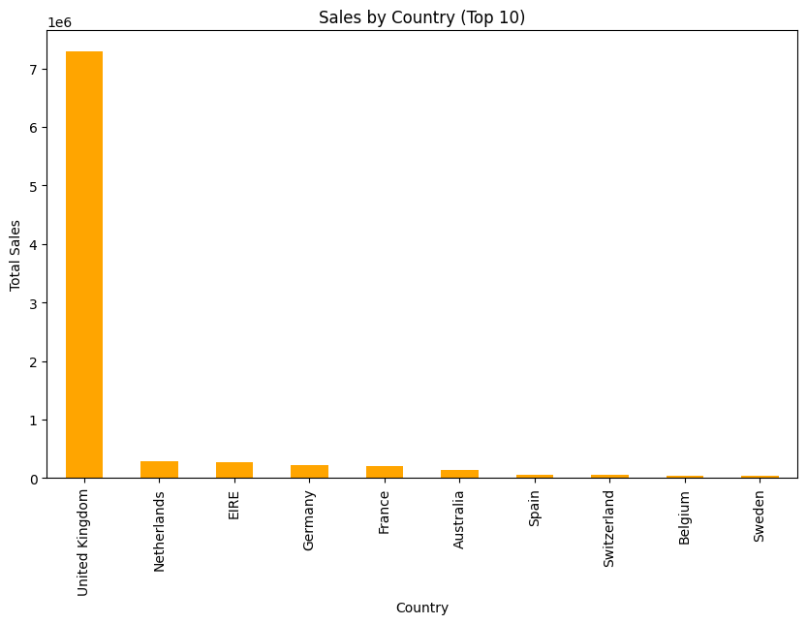
Sales by Country:
Top 10 countries contribute to 85% of revenue, with the UK dominating.

Slide 8
RFM Feature Engineering
Recency: Days since the last purchase.
Frequency: Number of purchases per customer.
Monetary: Total spend by customer.

Slide 9
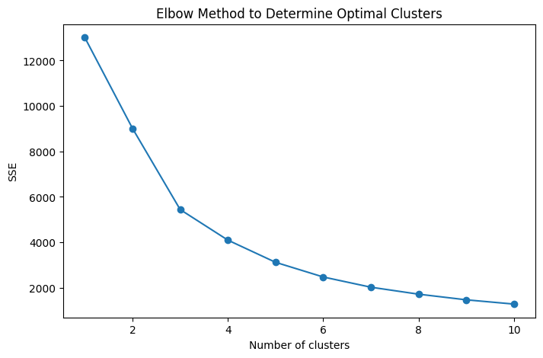
K-Means Clustering Insights
Elbow Method: Optimal number of clusters determined to be 4.
Cluster Profiles:
Cluster 0: Low Recency, moderate Frequency, low spend (Average customer).
Cluster 1: High Recency, low Frequency, low spend (At-risk customers).
Cluster 2: Low Recency, high Frequency, high spend (Top customers).
Cluster 3: Low Recency, moderate Frequency, high spend (Loyal customers).

Slide 10
Model Evaluation
Silhouette Score: 0.62, indicating well-defined clusters.
Performance: Good separation between customer groups for strategic targeting.

Slide 11
Recommendations
For Top Customers (Cluster 2): Focus on loyalty programs, exclusive offers.
For At-risk Customers (Cluster 1): Re-engagement strategies like email campaigns with incentives.
For Average Customers (Cluster 0): Increase basket size through upselling and cross-selling.
For Loyal Customers (Cluster 3): Offer personalized product recommendations to maintain loyalty.

Slide 12
Conclusion
Improved Customer Understanding: Tailored strategies for better engagement.
Actionable Insights for Targeted Marketing: Personalized strategies for each segment.
Revenue Optimization: Focus on high-spending and at-risk customers.
Scalability: Model can be retrained with new data for continuous improvement.
Next Steps: Implement marketing strategies and monitor segment performance.
Business Impact: Higher customer retention, increased lifetime value, and profitability.

Slide 13
THANK YOU

